Slide 1


Chapter 20
Remote Login: TELNET
Copyright © The McGraw-Hill Companies, Inc. Permission required for reproduction or display.

Slide 2
OBJECTIVES:
To introduce the TELNET protocol and show how it implements local and remote login.
To discuss options and sub-options used in TELNET and how they are negotiated.
To define out-of-band signaling in TELNET.
To define different modes of operations in TELNET.

Slide 3
20-1 TELNET
TELNET is an abbreviation for TErminaL NETwork. It is the standard TCP/IP protocol for virtual terminal service as proposed by ISO. TELNET enables the establishment of a connection to a remote system in such a way that the local terminal appears to be a terminal at the remote system.

Slide 4
Topics Discussed in the Section
Concepts
Time-Sharing Environment
Network Virtual Terminal (NVT)
Embedding
Options and Suboption Negotiation
Controlling the Server
Out-of-Band Signaling
Escape Character
Modes of Operation

Slide 5

Note
TELNET is a general-purpose client-server application program.

Slide 6
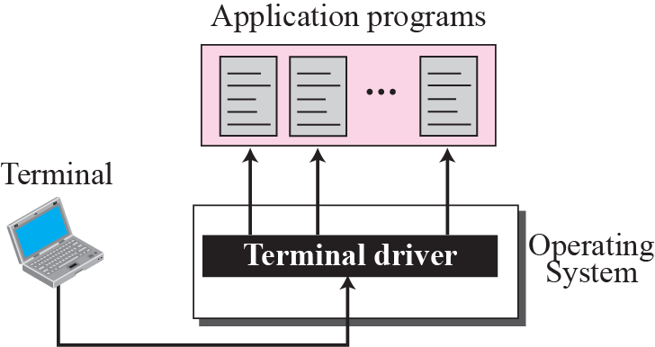
Figure 20.1 Local login

Slide 7
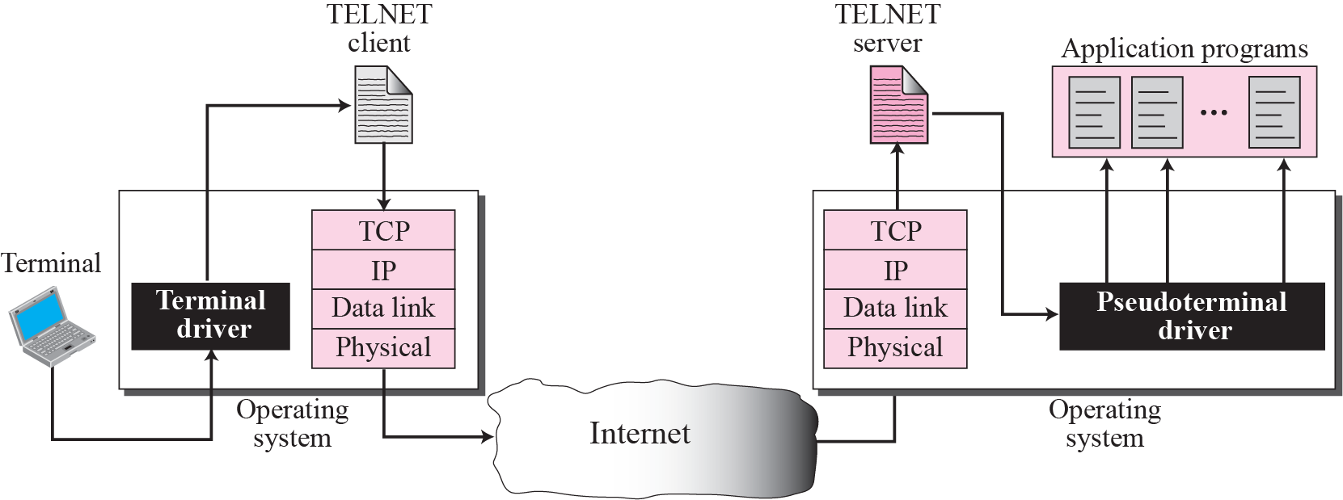
Figure 20.2 Remote login

Slide 8
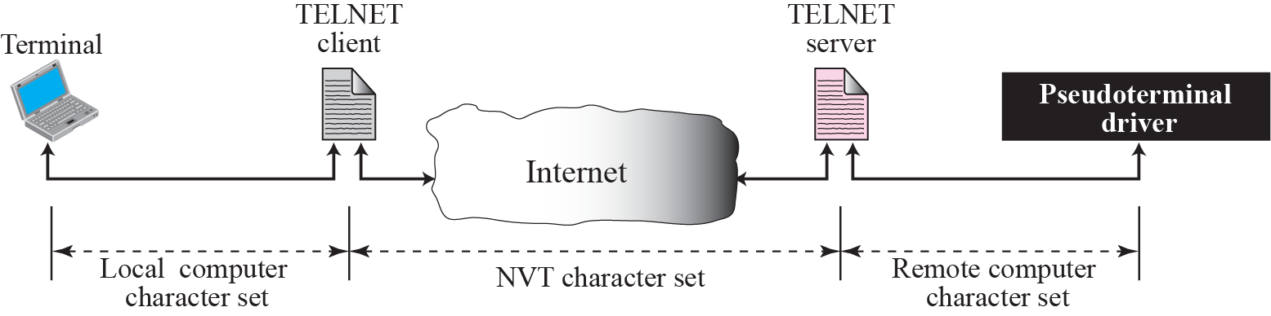
Figure 20.3 Concept of NVT

Slide 9
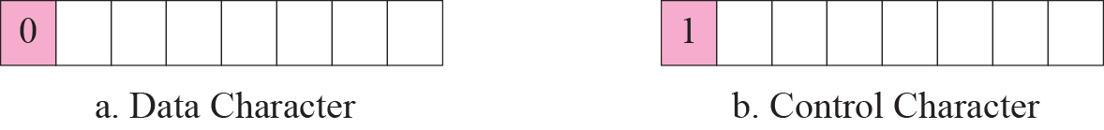
Figure 20.4 Format of data and control characters

Slide 11
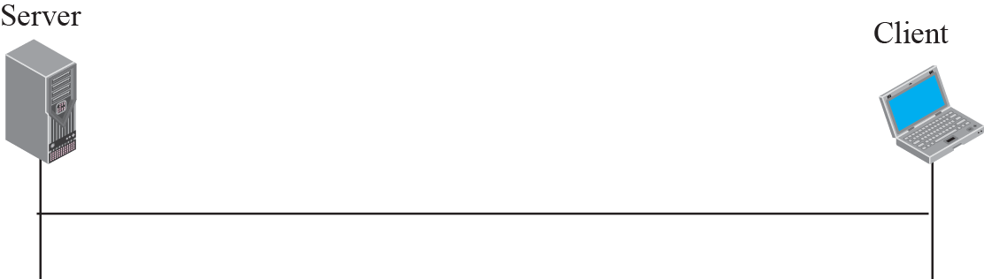
Figure 20.5 An example of embedding

Slide 13
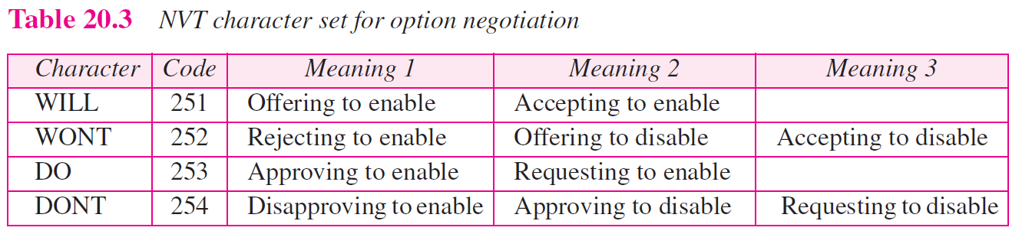

Slide 14
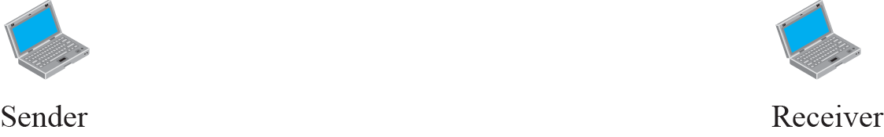
Figure 20.6 Offer to enable an option

Slide 15

Figure 20.7 Request to enable an option

